Slide 1
AI Resume Analyzer
CAPSTONE PROJECT
Presented By:
Student Name- Atibali Minhajali Saiyed
College Name- Charusat University
Department- CE

Slide 2
OUTLINE
Problem Statement
Proposed System/Solution
System Development Approach (Technology Used)
Algorithm & Deployment
Result
Conclusion
Future Scope
References

Slide 3
Problem Statement
In today’s competitive job market, recruiters receive a massive number of resumes for each job opening, making manual screening inefficient and time-consuming. Most organizations rely on Applicant Tracking Systems (ATS) to filter candidates, but these systems primarily depend on keyword matching and basic formatting, often failing to capture the true relevance and quality of a candidate’s profile.
From the candidate’s perspective, there is a lack of clarity on how well their resume aligns with a specific job role. Many applicants struggle to optimize their resumes according to job descriptions, industry expectations, and ATS requirements. Existing tools either provide generic suggestions or lack personalized, job-specific feedback, leading to missed opportunities even for qualified candidates.
Additionally, resume evaluation processes are often inconsistent and subjective, resulting in unfair or inaccurate shortlisting. This highlights the need for an intelligent, automated system that can analyze resumes effectively, provide structured scoring, and deliver actionable insights tailored to job requirements, ensuring better alignment between candidates and recruiters.

Slide 4
Proposed Solution
AI Resume Analyzer, is an intelligent web-based application designed to evaluate resumes against a given job description using Artificial Intelligence and rule-based analysis. Users can upload their resume in PDF format and provide job-specific details, after which the system processes the input and generates a structured evaluation. The platform leverages Large Language Models (LLMs) through APIs such as Groq and Gemini to perform deep semantic analysis of resume content.
The system combines AI-based understanding with heuristic techniques like keyword matching, ATS compatibility checks, and structural analysis to ensure accurate and consistent scoring. It evaluates resumes across multiple categories including skills match, content quality, formatting, and tone, and calculates a final weighted score. Additionally, it provides actionable feedback to help users improve their resumes according to industry standards and job requirements.
The solution also includes a user-friendly dashboard that allows users to view, manage, and revisit past resume analyses. By automating the evaluation process and providing job-specific insights, the system enhances resume quality, improves ATS performance, and bridges the gap between candidates and recruiter expectations.

Slide 5
System Approach
Backend:
Python 3.11
FastAPI + Uvicorn
SQLAlchemy (SQLite / PostgreSQL)
Groq API (LLaMA models)
Google Gemini (Fallback AI)
Frontend:
React 19 + TypeScript
Vite
Tailwind CSS
Zustand (State Management)
PDF Processing:
pdfplumber
pdf2image

Slide 6
Algorithm & Deployment
User uploads a PDF resume along with job description details.
The system extracts text from the resume using PDF processing tools.
AI model (Groq/Gemini) performs semantic analysis of the resume.
Keyword matching and structural heuristics are applied.
Scores are generated across five categories:
Skills Match (30%)
Content Quality (25%)
ATS Compatibility (20%)
Structure & Formatting (15%)
Tone & Style (10%)
Final score is calculated using weighted average.
Actionable feedback is generated for improvement.

Slide 7
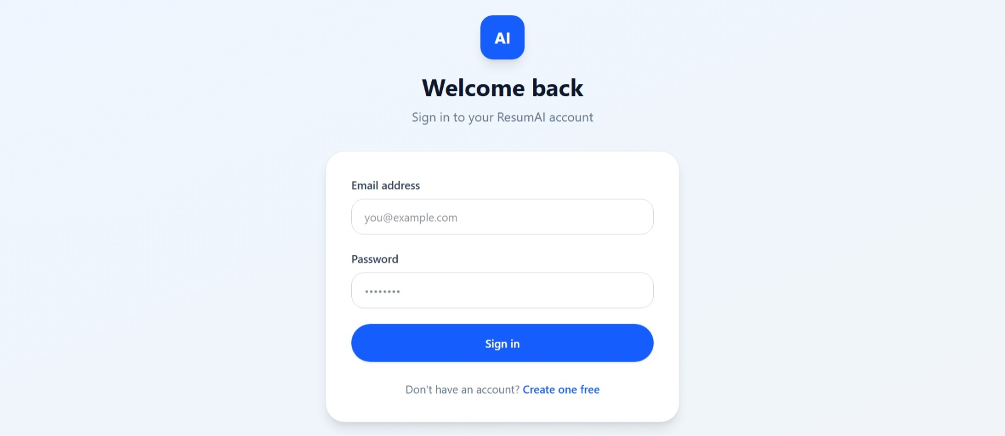
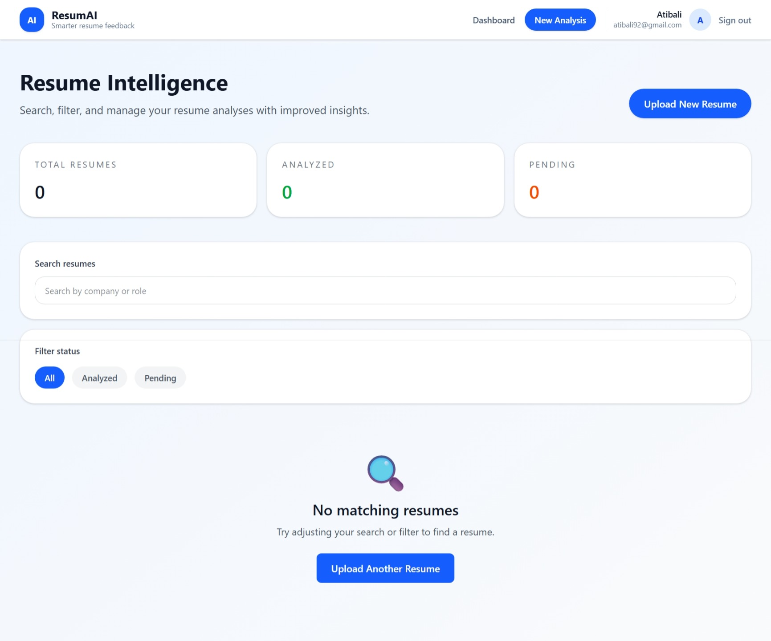
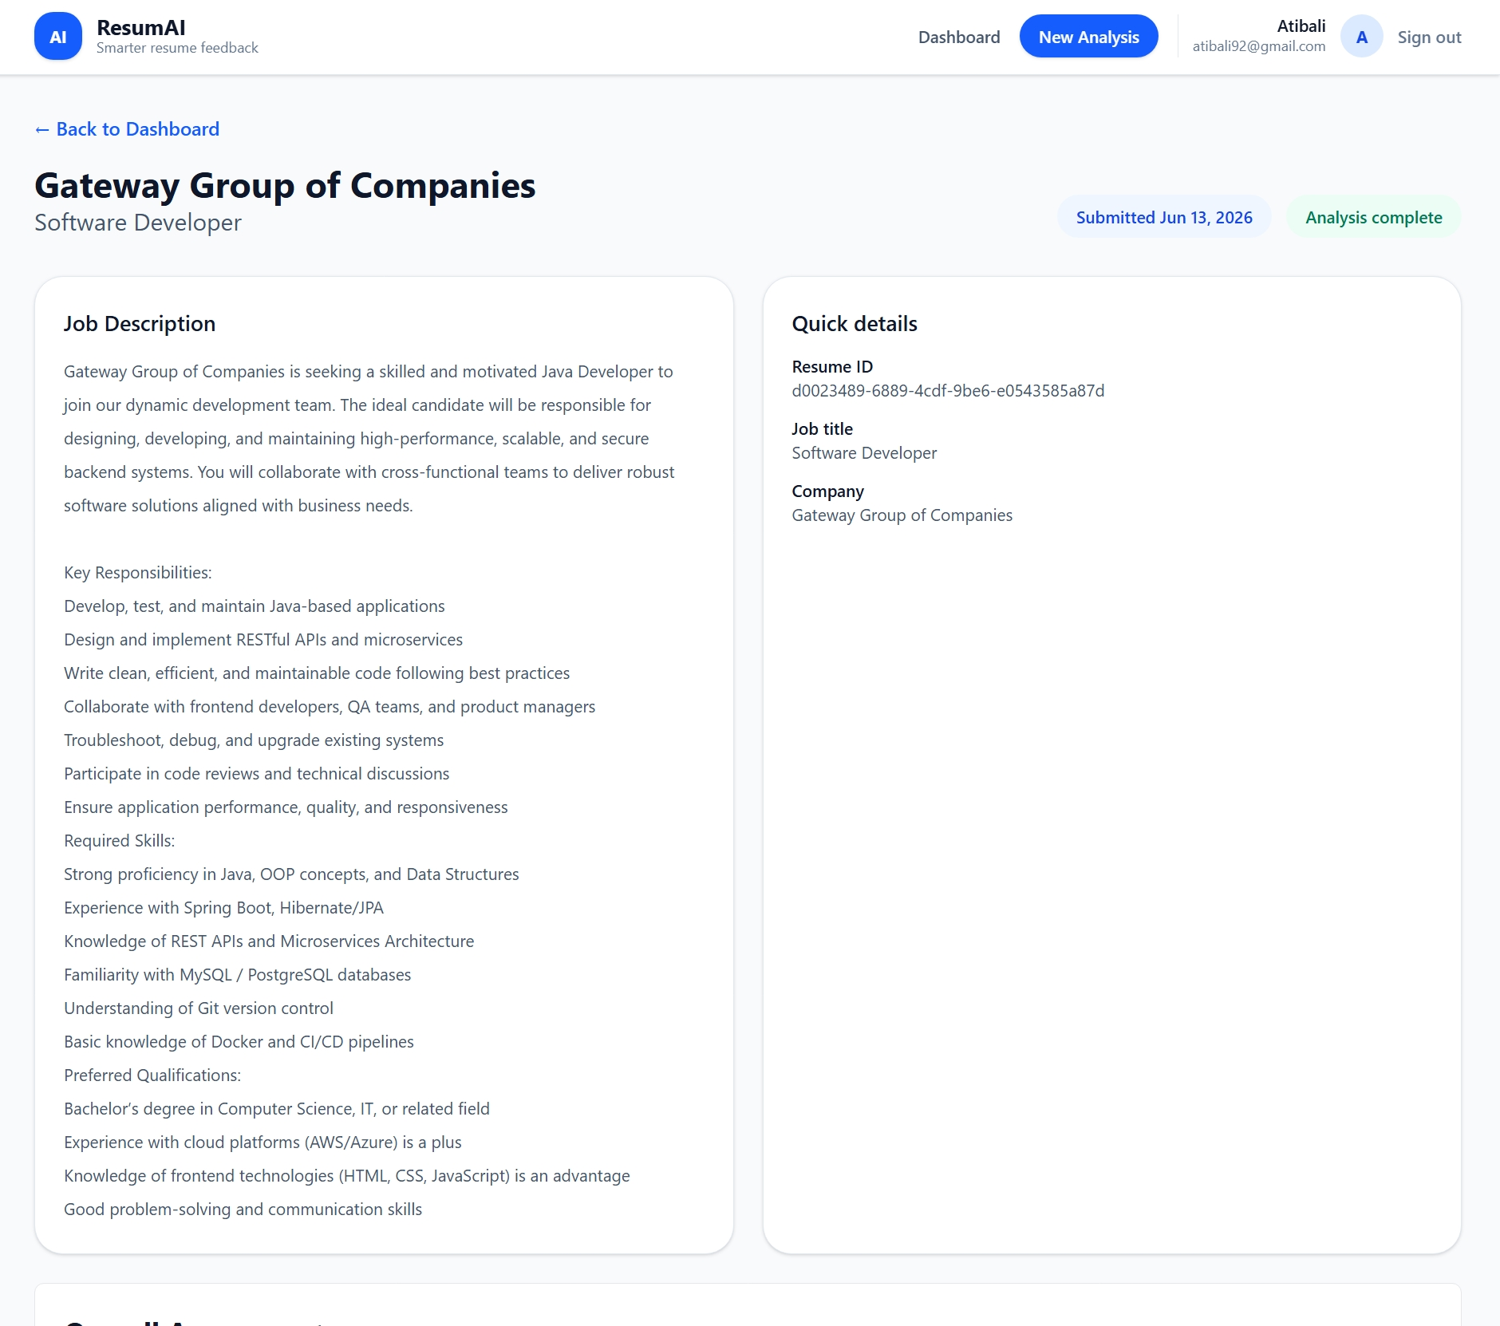
Result

Slide 8
Conclusion
The AI Resume Analyzer demonstrates the effective use of Artificial Intelligence in recruitment and career development. By combining LLM-based semantic analysis with rule-based scoring, the system provides accurate, consistent, and scalable resume evaluation while reducing manual effort in the screening process.
It offers job-specific, actionable feedback that helps candidates improve their resumes and align better with recruiter expectations. The user-friendly interface and structured scoring system make the solution practical and accessible.
Overall, the project highlights how AI can be used to simplify complex processes and enable smarter, data-driven decisions in hiring.

Slide 9
Future Scope
Integration with LinkedIn for automatic profile import
Resume-job matching recommendation system
Advanced ML models for personalized scoring
Multi-language resume analysis
Real-time resume editing suggestions
Cloud deployment with user authentication and analytics dashboard

Slide 10
References
Groq API Documentation.
Replit Publishing
Google Gemini (Google AI) Documentation
FastAPI Documentation
React Documentation
Research on Applicant Tracking Systems
Natural Language Processing (NLP) Overview

Slide 11
Github link
Github Link : https://github.com/Atibali/AI-Resume-Analyser#ai-resume-analyzer
Deployment Link: https://ai-resume-analyser--atibprac.replit.app/

Slide 12
THANK YOU

